Slide 1


Fuzzy Cognitive Map - Decision Tree for making medical decisions
Hoang Thien Ly
Weekly Seminar at MI2 DataLab
Monday, March 21, 2022

Slide 2
Outline
1/ Fuzzy Cognitive Map
2/ Conversation of medical doctors
3/ Decision Tree
4/ Hybrid model FCM-DT
Weekly Seminar at MI2 DataLab
Monday, March 21, 2022

Slide 3
Outline
Outline
1/ Fuzzy Cognitive Map
2/ Conversation of medical doctors
3/ Decision Tree
4/ Hybrid model FCM-DT
Weekly Seminar at MI2 DataLab
Monday, March 21, 2022

Slide 4
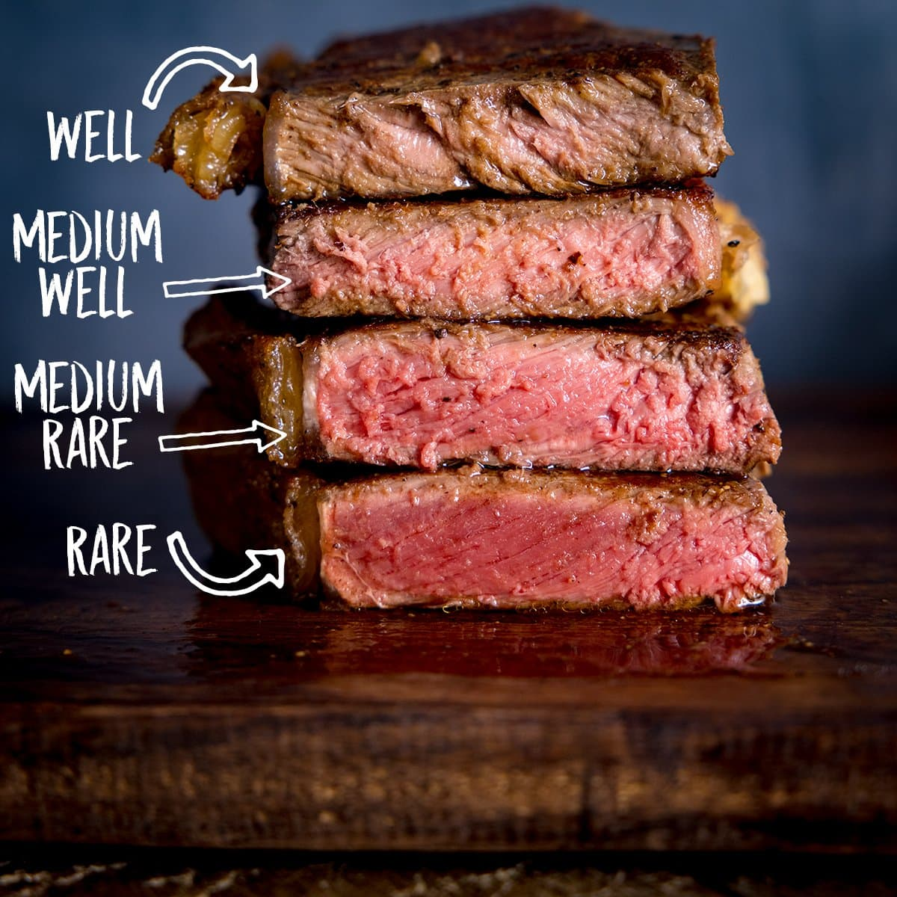
Boolean logic vs. fuzzy logic
Yes / 1
Very much/ 1
Fairly so/ 0.75
Is steak done?
Is it hot?
Medium/ 0.5
Somewhat/ 0.25
No / 0
Very little/ 0.1

Slide 5
Boolean logic vs. fuzzy logic
Yes / 1
Very much/ 0.9
Fairly so/ 0.7
Is it hot?
Moderate/ 0.5
Somewhat/ 0.25
No / 0
Little/ 0.1

Slide 6
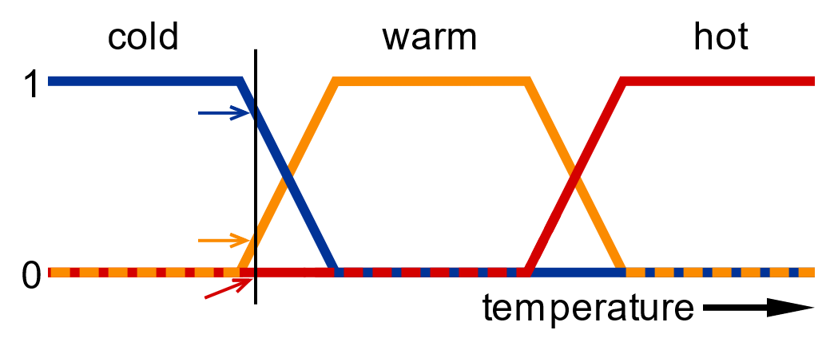
Degree of membership
At 0⁰C 0.8 in “cold”, 0.2 in “warm”

Slide 7
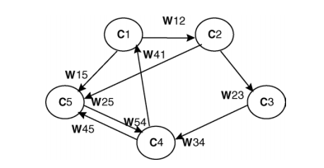
Fuzzy Cognitive Map
- Consist of nodes (concepts) & weights.
- Nodes ~ attributes, Weight [-1,1] ~ relation

Slide 8
Three possible types of causal relationships:
W_{ji} > 0: positive causality C_{i} and C_{j}. An increase (decrease) in value of C_{j} leads to an increase (decrease) in value of C_{i}.
W_{ji} < 0: negative causality.
W_{ji} = 0: no relationship.

Slide 9
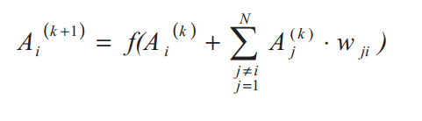



Value of each concept is the influence of other concepts to the specific concept, calculated by:
where:
: value of C_{i} at time k+1
: value of C_{j} at time k
::: sigmoid threshold function

Slide 10
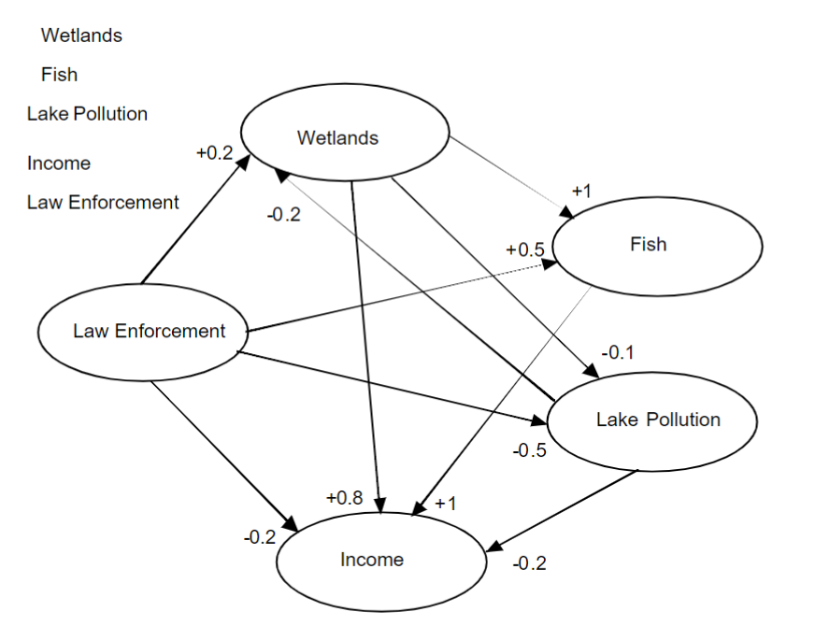
Ozesmi, U. (2004) Ecological models based on people’s knowledge: a multi-step fuzzy cognitive mapping approach. Ecological Modelling, 176(1), 43-64

Slide 11
Outline
Outline
1/ Fuzzy Cognitive Map
2/ Building Fuzzy Cognitive Map
3/ Decision Tree
4/ Hybrid model FCM-DT
Weekly Seminar at MI2 DataLab
Monday, March 21, 2022

Slide 12


I think I am having bladder tumor (guz pęcherza moczowego).
Please perform a tumor grading for me to check my illness.

Slide 13
Alright! In general, bladder tumors are graded 1,2 and 3:
G1: similar to normal cells, slow-growing (low grade)
G2: less like normal cell (high grade)
G3: very different from normal cell

Slide 14
Main variables to consider are:
C1: cell distribution
C2: cell size
C3: cell number
C4: cytoplasm (cytoplazma)
C5: nuclei
C6: nucleoli C7: necrosis
C8: mitosis C9: tumor grade

Slide 15
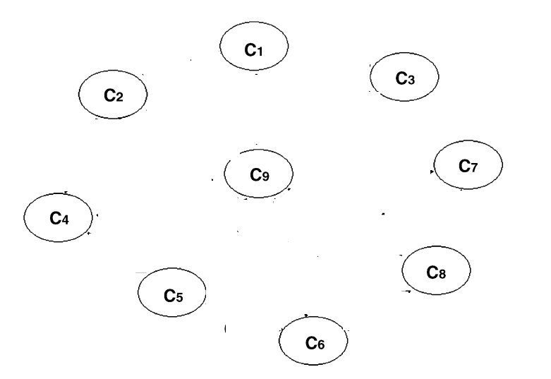

Slide 16
IF-THEN rule
Influence value in [0,1]
Fuzzy set {very very low, very low, low, medium, high, very high, very very high}
Eg: IF a small change occurs in value C₁ (cell distribution), THEN a small change is caused in value C₉ (tumour grade)
➔ The influence from C₁ to C₉ is positive very low.

Slide 17
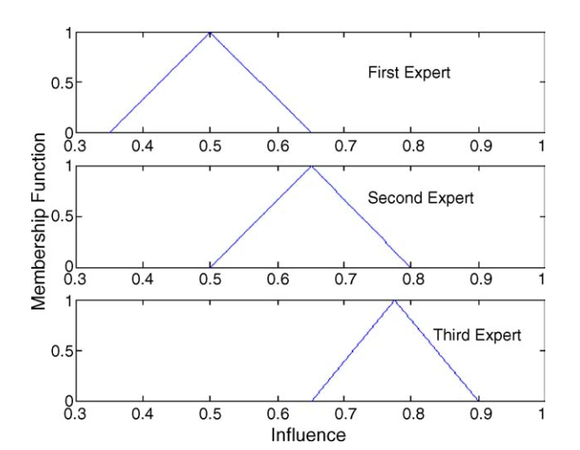
Expert 1: Influence from C₅ to C₉ positive medium
Expert 2: Influence from C₅ to C₉ positive high
Expert 3: Influence from C₅ to C₉ positive very high

Slide 18
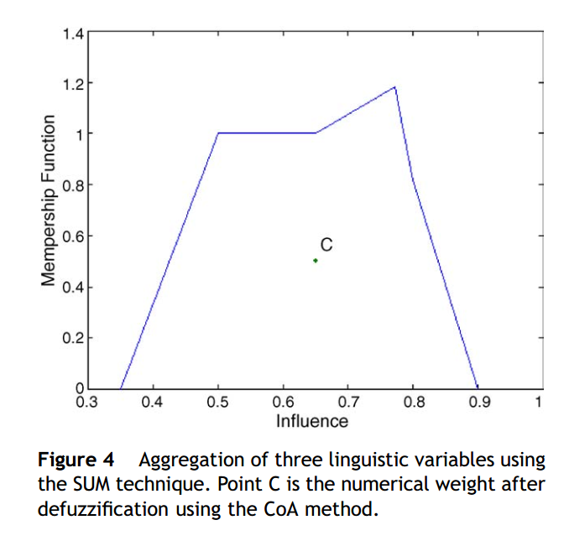
W₅₉ = 0.65

Slide 19
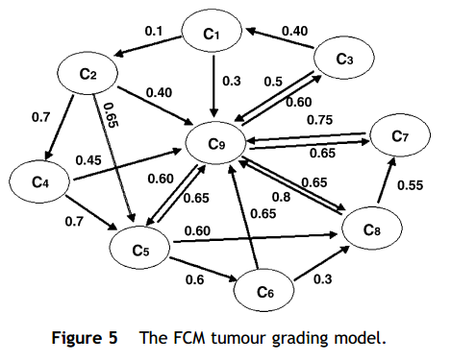
Ready to assign grade of every tumor!!

Slide 20
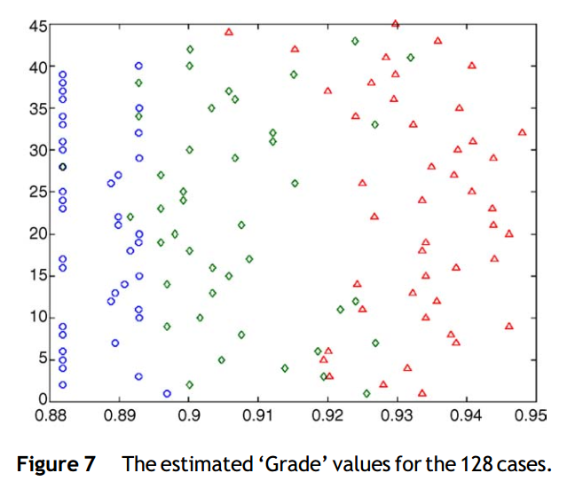
-> Initial value of C₉ was set a random value in [0,1]
-> AHL algorithm (Activation Hebbian Learning)
-> Value of C₉ (grade for tumor)

Slide 21
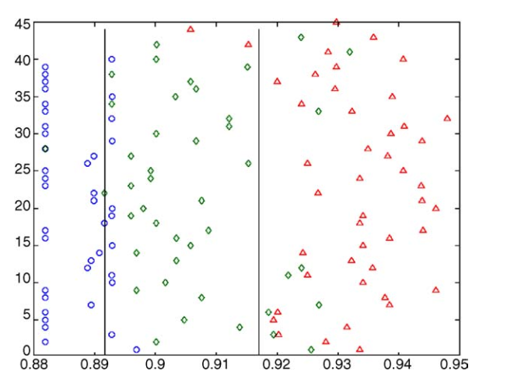

Slide 22
Bright sides of FCM:
Unlimited number of medical doctors
Combination of theories of neural network & fuzzy
Effective decision-making technique
High performance
Gathering existing & domain knowledge
Have been used, especially for radiotherapy
….

Slide 23
Dark sides of FCM:
Heavily relies on human experience
Undesired traps of steady states
Inability of physicians working with big data, especially
quantitative data
….

Slide 24
Outline
Outline
1/ Fuzzy Cognitive Map
2/ Building Fuzzy Cognitive Map
3/ Decision Tree
4/ Hybrid model FCM-DT
Weekly Seminar at MI2 DataLab
Monday, March 21, 2022

Slide 25
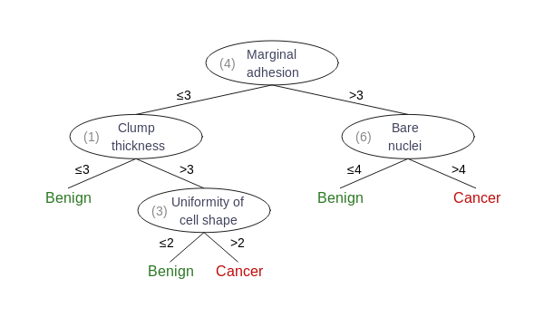
Set of IF-THEN rules

Slide 26
Outline
Outline
1/ Fuzzy Cognitive Map
2/ Building Fuzzy Cognitive Map
3/ Decision Tree
4/ Hybrid model FCM-DT
Weekly Seminar at MI2 DataLab
Monday, March 21, 2022

Slide 27
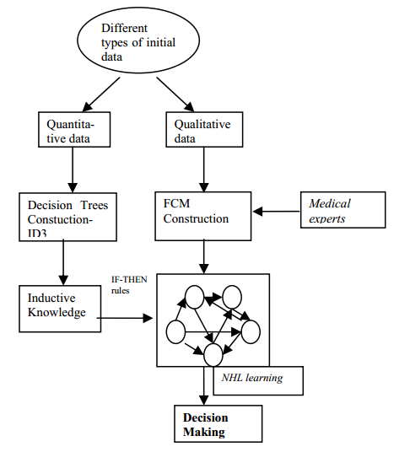

Slide 28
References:
Podgorelec V, Kokol P, Stiglic B, Rozman I. Decision trees: an overview and their use in medicine. J Med Syst. 2002 Oct;26(5):445-63. doi: 10.1023/a:1016409317640. PMID: 12182209.
Papageorgiou, E., Stylios, C., Groumpos, P. (2003). Fuzzy Cognitive Map Learning Based on Nonlinear Hebbian Rule. In: Gedeon, T.(.D., Fung, L.C.C. (eds) AI 2003: Advances in Artificial Intelligence. AI 2003. Lecture Notes in Computer Science(), vol 2903. Springer, Berlin, Heidelberg. https://doi.org/10.1007/978-3-540-24581-0_22
Papageorgiou, Elpiniki & Stylios, Chrysostomos & Groumpos, Peter. (2007). Hybrid model based on Decision Trees and Fuzzy Cognitive Maps for Medical Decision Support System. 10.1007/978-3-540-36841-0_934.
Papageorgiou EI, Spyridonos PP, Stylios CD, Ravazoula P, Groumpos PP, Nikiforidis GN. Advanced soft computing diagnosis method for tumour grading. Artif Intell Med. 2006 Jan;36(1):59-70. doi: 10.1016/j.artmed.2005.04.001. Epub 2005 Aug 10. PMID: 16095888.

Slide 29
